Slide 1



Github

Slide 2


Viewing the Commit History
The commit history can be viewed in different ways by using the `git log` command.
A local repository named bash has been used in this tutorial to test the commands used in this tutorial.
Run the following command to view the commit history of the repository.
The output will contain the commit SHA value, username and email of the author, commit date and time, and the commit message.
$ git log
The output shows that two commits have been done in the current repository by the same author on the same date but at different times.
The commit history can be viewed based on the commit SHA value using the `git show` command. Run the following command to view the commit history of the given commit SHA.
$ git show ab35d03c8f4f238fd94f0ec3abd533dbe0b5a352

Slide 3
HTML Semantic Elements
The output shows the details of the commit history based on the particular commit SHA value.
The other information such as the filename, file mode, index value, and the content of the committed file have displayed here.
It helps the git user to identify the necessary commit that the user wants to modify or correct.
The -p or –patch option is used with the `git log` command to display the difference in each commit.
The view of the log entries can be limited by defining a specific number with this option.
Run the following command to display the latest commit history.
$ git log -p -1

Slide 4
HTML Semantic Elements
The –stat option is used with the `git log` command to display some state information with the commit history.
$ git log --stat
The output shows that the .gitattributes file has been inserted in the initial commit.
The bash-basic-tutorial.sh file has been inserted in the second commit of the repository with the other commit information.
The –online option of the `git log ` command displays the commit history in a single line with the short commit SHA value.
When the repository contains many commits, the `git log` command will long.
The output of all commit history can be displayed in the short form by using the –online option that helps to view a large number of commit history properly.
$ git log --online
The output will appear after executing the above command. Here, the first 7 characters of the commit SHA value have displayed for each commit.

Slide 5
HTML Semantic Elements
The –pretty is another option of `git log` to display the log output in various formats.
This option can be used by assigning different types of values, and the output of the command depends on the assigned value.
Run the following command to view the commit history in the short form by assigning online for the –pretty option.
$ git log --pretty=oneline
The output of the above command is similar to the previous command except for the commit SHA value.
Many placeholders exist, which are defined by the character literals to format the log output. The log output can be formatted according to the user’s requirement by defining the format with the proper string value in the –pretty option.
Run the following command to print the commit SHA value in the short form, the git username, and the commit message in the way that has been defined in the string.
Here, %h is used to display the commit SHA value in the short form, %an is used to display the author’s username, and %s is used to display the commit message.
$ git log --pretty=format:"%h - %an : %s"

Slide 6
Undoing Things
At any stage, you may want to undo something. Here, we’ll review a few basic tools for undoing changes that you’ve made.
Be careful, because you can’t always undo some of these undos. This is one of the few areas in Git where you may lose some work if you do it wrong.
One of the common undos takes place when you commit too early and possibly forget to add some files, or you mess up your commit message.
If you want to redo that commit, make the additional changes you forgot, stage them, and commit again using the --amend option:
$ git commit --amend

Slide 7
Working with Remotes
To be able to collaborate on any Git project, you need to know how to manage your remote repositories.
Remote repositories are versions of your project that are hosted on the Internet or network somewhere.
You can have several of them, each of which generally is either read-only or read/write for you. Collaborating with others involves managing these remote repositories and pushing and pulling data to and from them when you need to share work.
Managing remote repositories includes knowing how to add remote repositories, remove remotes that are no longer valid, manage various remote branches and define them as being tracked or not, and more.

Slide 8
Showing Your Remotes
To see which remote servers you have configured, you can run the
git remote command.
It lists the shortnames of each remote handle you’ve specified.
If you’ve cloned your repository, you should at least see origin — that is the default name Git gives to the server you cloned from:
You can also specify -v, which shows you the URLs that Git has stored for the shortname to be used when reading and writing to that remote:
$ git remote -v origin https://github.com/schacon/ticgit (fetch) origin https://github.com/schacon/ticgit (push)
If you have more than one remote, the command lists them all.

Slide 9
Adding Remote Repositories
To add a new remote Git repository as a shortname you can reference easily, run git remote add <shortname> <url>:
$ git remote origin $ git remote add pb https://github.com/paulboone/ticgit $ git remote -v origin https://github.com/schacon/ticgit (fetch) origin https://github.com/schacon/ticgit (push) pb https://github.com/paulboone/ticgit (fetch) pb https://github.com/paulboone/ticgit (push)
if you want to fetch all the information that Paul has but that you don’t yet have in your repository, you can run
git fetch pb:

Slide 10
Fetching and Pulling from Your Remotes
To get data from your remote projects, you can run:
$ git fetch <remote>
The command goes out to that remote project and pulls down all the data from that remote project that you don’t have yet. After you do this, you should have references to all the branches from that remote, which you can merge in or inspect at any time.
Pushing to Your Remotes
When you have your project at a point that you want to share, you have to push it upstream. The command for this is simple: git push <remote> <branch>.
If you want to push your master branch to your origin server (again, cloning generally sets up both of those names for you automatically), then you can run this to push any commits you’ve done back up to the server:
$ git push origin master

Slide 11
Inspecting a Remote
If you want to see more information about a particular remote, you can use the
git remote show <remote>
command. If you run this command with a particular shortname, such as origin, you get something like this:
$ git remote show origin
remote origin Fetch URL: https://github.com/schacon/ticgit
Push URL: https://github.com/schacon/ticgit
HEAD branch: master
Remote branches: master tracked dev-branch tracked
Local branch configured for 'git pull': master merges with remote master
Local ref configured for 'git push': master pushes to master (up to date)

Slide 12
Renaming and Removing Remotes
You can run git remote rename to change a remote’s shortname. For instance, if you want to rename pb to paul, you can do so with git remote rename:
$ git remote rename pb paul
$ git remote
origin
paul

Slide 13
Tagging
Git has the ability to tag specific points in a repository’s history as being important. Typically, people use this functionality to mark release points (v1.0, v2.0 and so on).
Listing Your Tags
Listing the existing tags in Git is straightforward. Just type git tag (with optional -l or --list):
$ git tag
Creating Tags
Git supports two types of tags: lightweight and annotated.
A lightweight tag is very much like a branch that doesn’t change — it’s just a pointer to a specific commit.
Annotated tags, however, are stored as full objects in the Git database.
They’re checksummed; contain the tagger name, email, and date; have a tagging message; and can be signed and verified with GNU Privacy Guard (GPG). It’s generally recommended that you create annotated tags so you can have all this information; but if you want a temporary tag or for some reason don’t want to keep the other information, lightweight tags are available too.

Slide 14
Annotated Tags
Creating an annotated tag in Git is simple. The easiest way is to specify -a when you run the tag command:
$ git tag -a v1.4 -m "my version 1.4"
$ git tag
v0.1
v1.3
v1.4 The -m specifies a tagging message, which is stored with the tag.

Slide 15
Lightweight Tags
Another way to tag commits is with a lightweight tag.
This is basically the commit checksum stored in a file — no other information is kept. To create a lightweight tag, don’t supply any of the -a, -s, or -m options, just provide a tag name:
$ git tag v1.4-lw
$ git tag
v0.1
v1.3
v1.4
v1.4-lw
v1.5
This time, if you run git show on the tag, you don’t see the extra tag information.

Slide 16
Tagging Later
You can also tag commits after you’ve moved past them.
$ git log --pretty=oneline
Sharing Tags
the git push command doesn’t transfer tags to remote servers.
You will have to explicitly push tags to a shared server after you have created them.
This process is just like sharing remote branches — you can run git push origin <tagname>.
$ git push origin v1.5
Deleting Tags
To delete a tag on your local repository, you can use git tag -d <tagname>. For example, we could remove our lightweight tag above as follows:
$ git tag -d v1.4-lw
Checking out Tags
f you want to view the versions of files a tag is pointing to, you can do a git checkout of that tag, although this puts your repository in “detached HEAD” state, which has some ill side effects:
$ git checkout v2.0.0

Slide 17
Git Aliases
Git doesn’t automatically infer your command if you type it in partially.
If you don’t want to type the entire text of each of the Git commands,
you can easily set up an alias for each command using
git config.
$ git config --global alias.co checkout
$ git config --global alias.br branch
$ git config --global alias.ci commit
$ git config --global alias.st status

Slide 18
Basic Branching and Merging
To create a new branch and switch to it at the same time, you can run the git checkout command with the -b switch:
$ git checkout -b iss53
Switched to a new branch "iss53“
Suppose you’ve decided that your issue #53 work is complete and ready to be merged into your master branch.
In order to do that, you’ll merge your iss53 branch into master, much like you merged your hotfix branch earlier.
All you have to do is check out the branch you wish to merge into and then run the git merge command:
$ git checkout master
Switched to branch 'master'
$ git merge iss53
Merge made by the 'recursive' strategy.
index.html | 1 +
1 file changed, 1 insertion(+)

Slide 19
Basic Branching and Merging
Basic Merge Conflicts
Occasionally, this process doesn’t go smoothly.
If you changed the same part of the same file differently in the two branches you’re merging, Git won’t be able to merge them cleanly.
If your fix for issue #53 modified the same part of a file as the hotfix branch, you’ll get a merge conflict that looks something like this:
$ git merge iss53
Auto-merging index.html CONFLICT (content): Merge conflict in index.html Automatic merge failed; fix conflicts and then commit the result.
Git hasn’t automatically created a new merge commit. It has paused the process while you resolve the conflict. If you want to see which files are unmerged at any point after a merge conflict, you can run git status:
$ git status
On branch master
You have unmerged paths. (fix conflicts and run "git commit") Unmerged paths: (use "git add <file>..." to mark resolution)

Slide 20
Branch Management
The git branch command does more than just create and delete branches. If you run it with no arguments, you get a simple listing of your current branches:
$ git branch
iss53
* master
testing
the * character that prefixes the master branch:
it indicates the branch that you currently have checked out (i.e., the branch that HEAD points to).
This means that if you commit at this point, the master branch will be moved forward with your new work. To see the last commit on each branch, you can run
git branch -v:

Slide 21
Changing a branch name
Suppose you have a branch that is called bad-branch-name and you want to change it to corrected-branch-name, while keeping all history.
You also want to change the branch name on the remote (GitHub, GitLab, other server).
Rename the branch locally with the git branch --move command:
$ git branch --move bad-branch-name corrected-branch-name
This replaces your bad-branch-name with corrected-branch-name, but this change is only local for now.
To let others see the corrected branch on the remote, push it:
$ git push --set-upstream origin corrected-branch-name

Slide 22
Changing the master branch name
Rename your local master branch into main with the following command:
$ git branch --move master main
There’s no local master branch anymore, because it’s renamed to the main branch.
To let others see the new main branch, you need to push it to the remote. This makes the renamed branch available on the remote.
$ git push --set-upstream origin main
After you’ve done all these tasks, and are certain the main branch performs just as the master branch, you can delete the master branch:
$ git push origin --delete master

Slide 23
Branching Workflows
Long-Running Branches
Topic Branches
Remote Branches
Remote references are references (pointers) in your remote repositories, including branches, tags, and so on.
You can get a full list of remote references explicitly with
git ls-remote <remote>, or
git remote show <remote> for remote branches as well as more information.
Pushing
When you want to share a branch with the world, you need to push it up to a remote to which you have write access.
$ git push origin serverfix Counting objects: 24, done.
Tracking Branches

Slide 24
Branching Workflows
Tracking Branches
Checking out a local branch from a remote-tracking branch automatically creates what is called a “tracking branch” (and the branch it tracks is called an “upstream branch”).
Tracking branches are local branches that have a direct relationship to a remote branch.
If you’re on a tracking branch and type git pull, Git automatically knows which server to fetch from and which branch to merge in.
$ git checkout --track origin/serverfix
Pulling
there is a command called
git pull -→which is essentially a git fetch immediately followed by a git merge in most cases.
Deleting Remote Branches
git push origin --delete serverfix

Slide 25
Rebasing
In Git, there are two main ways to integrate changes from one branch into another: the merge and
the rebase.
The Basic Rebase
$ git checkout experiment
$ git rebase master First, rewinding head to replay your work on top of it...
Applying: added staged command
More Interesting Rebases
$ git rebase --onto master server client
$ git checkout master $ git merge client
$ git rebase master server

Slide 26
Git Branching Workflows
Long Running Branches
In Github one can merge one branch with another multiple times
Many Git developers have a workflow, having only code that is stable in the master branch. (The code that will be released)
Another parallel branch named develop or next which they work or test stability
Whenever the branch gets stable it will be merged with the master branch

Slide 27
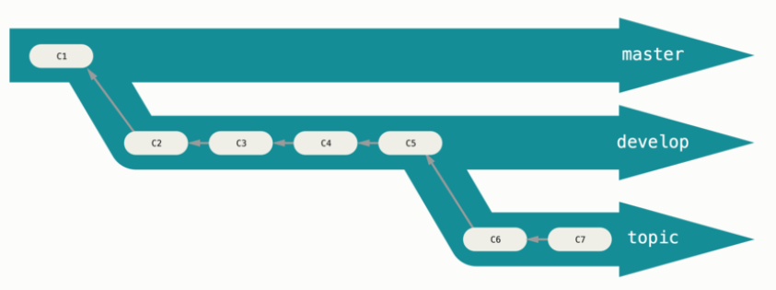
Git Branching Workflows
Long Running Branches
This process can be iterated till stability
Some larger projects have proposed branch that has integrated branches that may be ready to go into the next or master branch.
The idea is that your branches are at various levels of stability
When they reach the more stable level they are merged to the master branch.

Slide 28
Git Branching Workflows
Topic Branches
Topic Branches are used in projects of any size
It is a short lived branch that you create and use for a single particular feature or related work
But work, create, merge and delete is something very common in github
Once the branch is merged to the master branch the branch can be deleted
This technique allows you to context-switch quickly and completely
As your work is separated into silos where all the changes in that branch have to do with that topic and easier to see what has happened during code review
You can merge files into the master branch whenever you want regardless of the day and time it had been created.

Slide 29
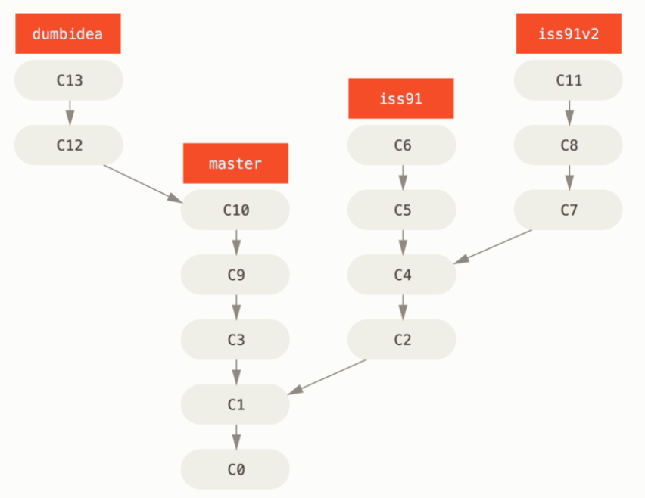
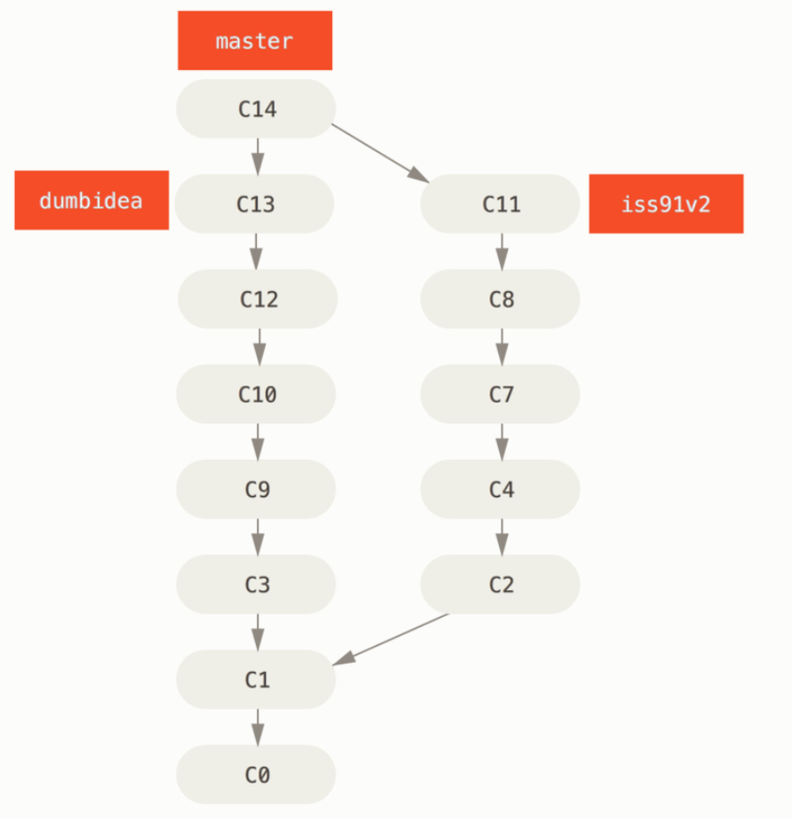
Git Branching Workflows

Slide 30
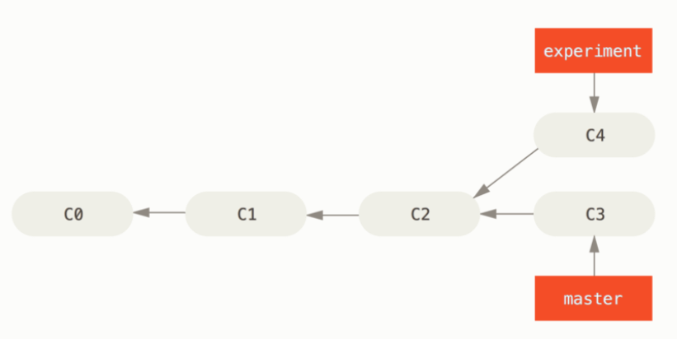
Rebasing
In Git, there are two main ways to integrate changes from one branch into another. – The merge and The Rebase
The Basic Rebase:
It merges C3 and C4 to commit C2

Slide 31
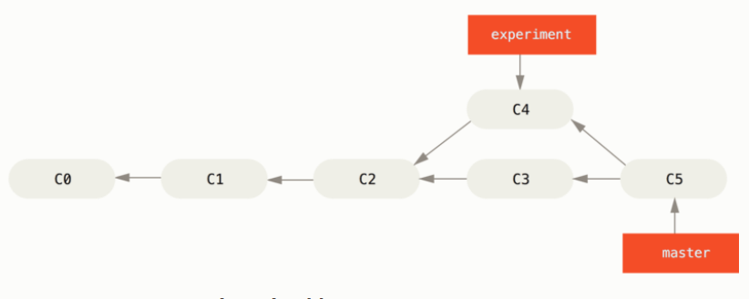
Rebasing
The Rebase:
Another methodology is take a patch of the change that was introduced in C4 and reapply it on top of C3. It Git, this is called Rebasing.

Slide 32
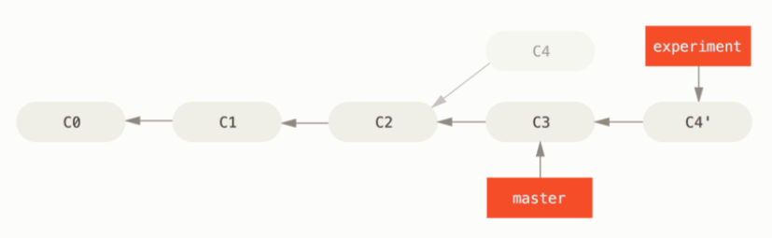
Rebasing
The Rebase:
In the following figure we can see the changes rebased in C3 and C4 is introduced into the master file
At this point we can go to the master and do a fast forward merge
Examining the log of a rebased branch, it looks like a linear history.
It appears that all the work happened in series, even when it originally happened in parallel.
Rebasing replays changes from one line of work onto another in the order they were introduced, whereas merging takes the endpoints and merges them together.

Slide 33
Rebasing
Dangers in Rebasing
Do not rebase commits that exists outside your repository and that people may have based work on.
If you push commits somewhere and others pull them down and base work on them, and then your rewrite those commits with git rebase and push them up again, your collaborators will have to remerge their work and things will get messy when you try to pull their work back into yours.

